Slide 1
PROJECT TITLE
Simple and Formal Resume
Digital portfolio using Frent end development

Slide 2


AGENDA
Problem Statement
Project Overview
End Users
Tools and Technologies
Portfolio design and Layout
Features and Functionality
Results and Screenshots 8. Conclusion
9. Github Link
3/21/2024 Annual Review

Slide 3

PROBLEM STATEMENT
A normal paper resume is plain and limited in design, which makes it hard to show creativity and stand out. To solve this, I created a digital resume that presents my personal details, skills, education, and projects in a clear, attractive, and easily accessible way.

Slide 4

PROJECT OVERVIEW
The project focuses on developing a DigitalPortfolio Website to showcase personal details, academic background, technical skills, and project work. The portfolio emphasizes user- friendly design, responsive layout, and interactive elements, enabling viewers to navigate easily and understand the profile.

Slide 5

WHO ARE THE END USERS?
Students & Professionals - To showcase their skills and
achievements.
Recruiters & Employers - To evaluate candidates' capabilities beyond a traditional resume.
Academic Institutions - For student project submissions and
evaluations.

Slide 6

TOOLS AND TECHNIQUES
Front-end: HTML, CSS, JavaScript.
Version Control: GitHub Design Tools: Canva(for layout
design)

Slide 7
PORTFOLIO DESIGN AND LAYOUT
Home page: Introduction and Banner Section.
About Section: Personal Details, Academic Profile.
Skills Section: Technical expertise and Skills.
Contect Section: Address, email and phone number.
8

Slide 8

PORTFOLIO DESIGN AND LAYOUT
Proper use of fonts, spacing, and alignment makes the design professional.
The layout is simple, attractive, and user- friendly, making the information easy to follow.

Slide 9


FEATURES AND FUNCTIONALITY
Provides a clear and organized structure for personal, academic, and professional details.
Interactive navigation with responsive
design.
Accessible anytime and anywhere in digital
format.
Compatible across devices such as laptops, tablets, and smartphones.
Contact form for direct communication.

Slide 10

RESULTS AND SCREENSHOTS
Successfully deployed Digital Portfolio Website Enhanced visibility of projects and skills Positive feedback from peers and mentors
3/21/2024 Annual Review

Slide 11
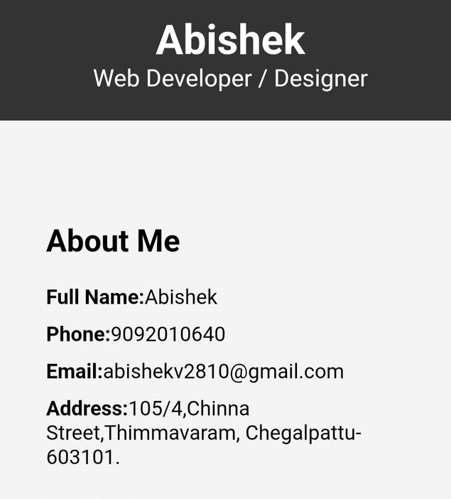
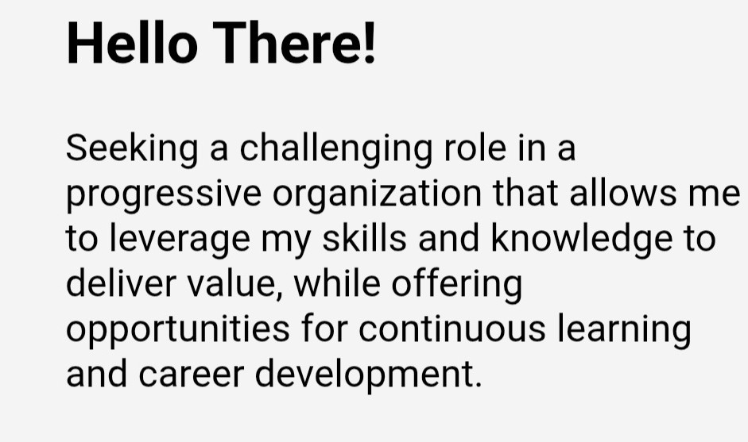
RESULTS AND SCREENSHOTS
11

Slide 12
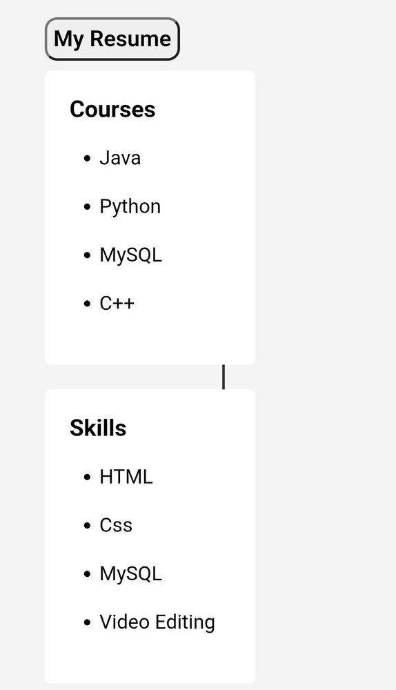
RESULTS AND SCREENSHOTS
11

Slide 13
CONCLUSION
This project provides a simple and creative way to present details in a digital format. It is easy to update, accessible, and more attractive than a traditional resume.
11

Slide 14
GitHub Link
https://github.com/SHYMSON123/SYMPSON.git
11

